Slide 1

Getting Ready For School
Reception Year
Notes:
Leave up until all seated.

Slide 2
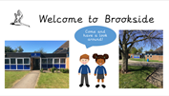
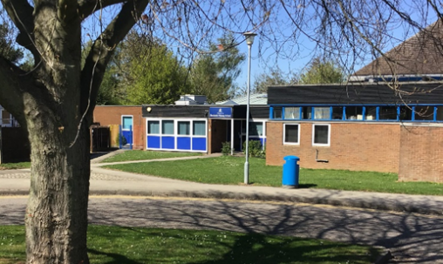

What can I do to prepare my child?
*Share the photo booklet (on website>parent guidance) with them regularly to help them become familiar with all of the staff and their new classroom.
*Talk to them in a relaxed way, for example when playing, about starting School, making new friends and what they would like to learn. Even if you are feeling anxious it is key that you reassure them and are positive.
*If you are able to, walk past School a few times and wave.
*Everytime you do something new or visit somewhere they have never been before link it to starting School. “We have never been there before, I am proud of you for trying something new”
*Most importantly-don’t panic- Children are amazingly resilient and if we work together we can help to make the
transition to School smooth.

Slide 3
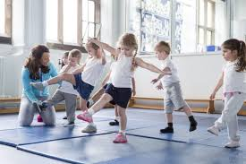
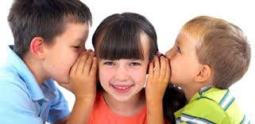
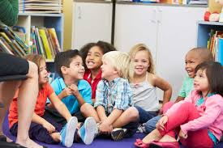
Prime areas of learning
*You can support your child by doing some activities at home that support the Prime Areas of Learning. These are very important areas of learning and without a solid grounding in these, children may struggle to make progress in the other areas of learning.
*Personal, Social and Emotional Development-This area covers how children make relationships with their peers and familiar adults, how confident they are and how they manage their feelings and behaviour. It also covers self care skills.
*Physical development-This area covers gross motor (large movements)
and fine motor (small movements) skills.
*Communication and Language-This area includes how children listen and concentrate, their understanding of language and their expressive skills.
Notes:
Show folder.
Explain re: children will follow this curriculum throughout their time in FS, and beyond if necessary.
Different levels for children at different stages of development – so for example a writing activity might give children the opportunity to engage by either making marks on paper, forming proper letter shapes, copying their name, or writing their name from memory.

Slide 4
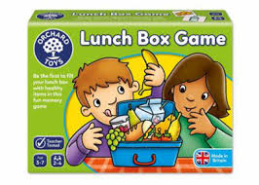
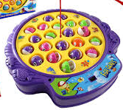
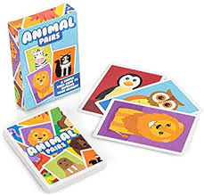
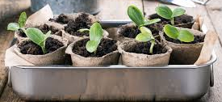
Personal and Social development
There are lots of things that you are already doing that are supporting your child in developing their skills in this area. Here are a few extra ideas
*Play games with your child that involves taking turns. If your child finds it hard to take turns play first with you and your child and then at another time add another person. You could play snap, pairs, connect 4, snakes and ladders, lotto, bingo.
*Encourage your child to try new things- maybe visit somewhere new, walk a different way to the shops.
*Talk about feelings and you can use pictures to help you. “I can see you are feeling tired/sad/happy today”
*Children enjoy small responsibilities- can you plant a seed and encourage your child to care for it? Talk about what it needs to grow and encourage them to remember when to water it etc

Slide 5
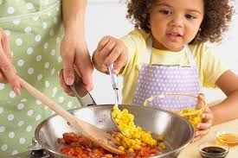
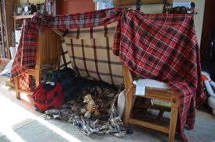
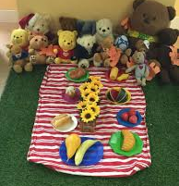
Personal and Social development
*Cook together- take it in turns to put in a spoonful of ingredients. Decide together what colour the icing will be or what toppings to put on the pizza. Encourage your child to respond to your needs and sometimes they chose what to cook and sometimes you choose.
*Taking part in role play is a great way to develop personal and social skills. Can you make a den in the garden or indoors with blankets? Can you have a picnic with your toys? Can you make some pretend breakfast? (you can save old cereal boxes, tubs etc if you don’t have any play food or use real fruit/veg)
* *Have a go at a jigsaw puzzle together.

Slide 6
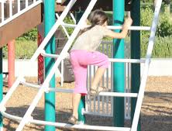
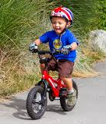
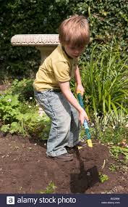
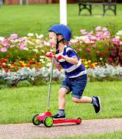
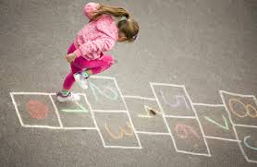
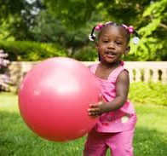
Physical Development
* Gross motor skills-are the skills needed to control the large movements and involve jumping, hopping, running etc These are crucial for your child to then develop good fine motor control needed for writing and doing buttons for example.
* Have a go at some of these activities

Slide 7
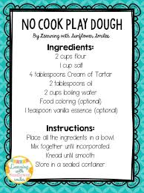
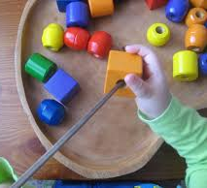
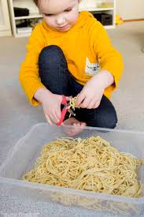
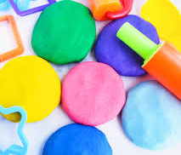
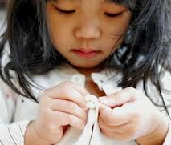
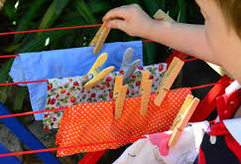
Physical Development
*Fine motor skills are the skills required to control smaller actions such as picking up or grasping objects. It will really help your child if they have strong hands and can manipulate objects. The activities below will help with this.

Slide 8
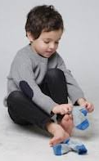
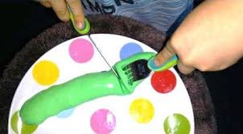
Looking after themselves
An important aspect is health and self care. We will help the children but
it really does help their self esteem if they can
* get undressed and dressed
* put socks and shoes on (Velcro shoes please)
* put on their coat and do up the zip
* use the toilet and wipe themselves with tissue afterwards
* wash and dry their hands
*cut up their food and feed themselves using a knife and fork or spoon
Try
*having a practice at getting dressed for School or putting PE kit on
*have a race to get dressed (you may have to let them win a few times!) Or set a timer- how many things can you put on in 2 minutes?
*play with dressing up clothes and old shoes
*make playdough food and try cutting it up

Slide 9
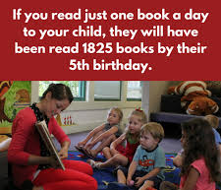
Communication and language
Communication and Language is so important and covers 3 areas
Listening, Attention and understanding-Can children listen attentively and process what they are hearing? Young children need to be taught to listen and really think about what they are hearing and seeing-rather than passive listening.
These activities will help with this
*Play Who am I? Give your child some clues about an animal. Can they guess what animal it is? E.g. I have a long trunk and like to squirt water.. Remember to make sure your child is looking at you when you are talking.
*Go on a listening walk- stand still and listen. What can you hear?
Share stories together. This is a lovely way to develop language and many other skills. Join your local library it is completely free
and you can borrow books and they often do holiday
sessions too.

Slide 10
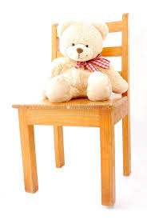
Understanding of language
*Children need to understand what they are hearing and be able to follow simple instructions e.g. “please put your coat on your peg” or more complicated ones “please put your coat on your peg and come and sit on the carpet”.
*Play hide the teddy- Ask your child to close their eyes, hide their teddy/toy. Ask them to open their eyes, describe where it is hidden but do not point! You might say “teddy is underneath/on top/next to the wooden chair.”
*Talking all the time when out and about- asking your child a variety of questions e.g. “How did we make the pizza?” “Why did the bird fly away?”
*Vary routines slightly for example “today please can you put your shoes outside the back door”
* www.speechandlanguage.info/parents has some information on ways to develop language skills

Slide 11
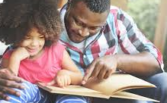
Speaking
Talking about what they are doing/learning helps children to remember new skills. In the Reception classroom we are talking all of the time! We would like children to be confident to talk in clear sentences and share their thoughts.
*Model talking about what you are doing e.g. “I am just making a tower. I think I will put this red block on first then a blue one…”
*Look at photographs of family or places you have been and talk about them Eg “Can you remember, what did you eat when we went to the park?”
*If your child is struggling to talk maybe give them 2 options. If you ask “what did you have for breakfast” and they can’t remember give them 2 options eg “was it Cereal or toast?” This is more helpful than just giving them the right answer.
*Look at favourite books together, share poems and rhymes.

Slide 12


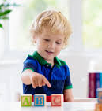
Some extra bits to do..
*Write your child's name out and stick around the house. Please write it in lower case – Ben rather than BEN.
Add other family member names and send your child on a name hunt-can they bring back just their name-collect them in a bucket, bag, bowl…
*If they want to start writing their name- write it in yellow and they can write over the top in lots of different colours. (All letters start from the top) Don’t worry if they can’t write their name, we will be teaching this in School along with letter formation.
*Look for numbers when you are out and about- on doors, signs and
vehicles
*Count everything- How many cars have you got? I have 5 peas on my plate….

Slide 13

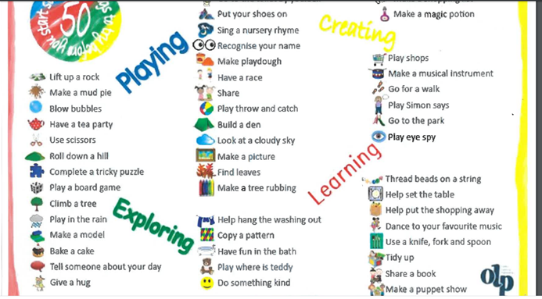
*Send us a postcard or picture of something you do over the summer holiday. We will display them in the classroom ready for when the children come to School.
Please send them to Butterfly classes
Brookside Primary School
Copse Close
Oadby
Leicester LE2 4FU
*How many of the 50 things to do before you start School can you do?

Slide 14

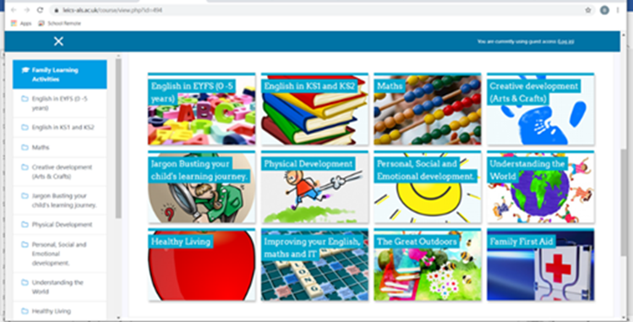
Useful websites
*The Government have put lots of lovely activity ideas on here. There are also sections for younger children if you have little ones at home too!
https://hungrylittleminds.campaign.gov.uk/
www.leics-als.ac.uk/familyfun The Go learn team at Leics county Council have set up a website with fun activities and resources for parents/carers to do with their children at home.

Slide 15

*We are looking forward to welcoming you all to Brookside!
*We hope you enjoy doing some of these activities but please do not feel pressurised to do them all.
Every child is different and will start school with different strengths and areas to develop. We take each child, nurture them and help them develop their next steps.
*Home visits- 26^{th -29th} August
*Part time start 1st-5th September
*Full time 8th September
*If you have any queries or questions you can contact the Reception Teachers on
office@brookside.leics.sch.uk
Notes:
please wait in the cloakroom.
please wait until a member of staff opens the doors. You can then come into the classroom to collect your child.

