Slide 1
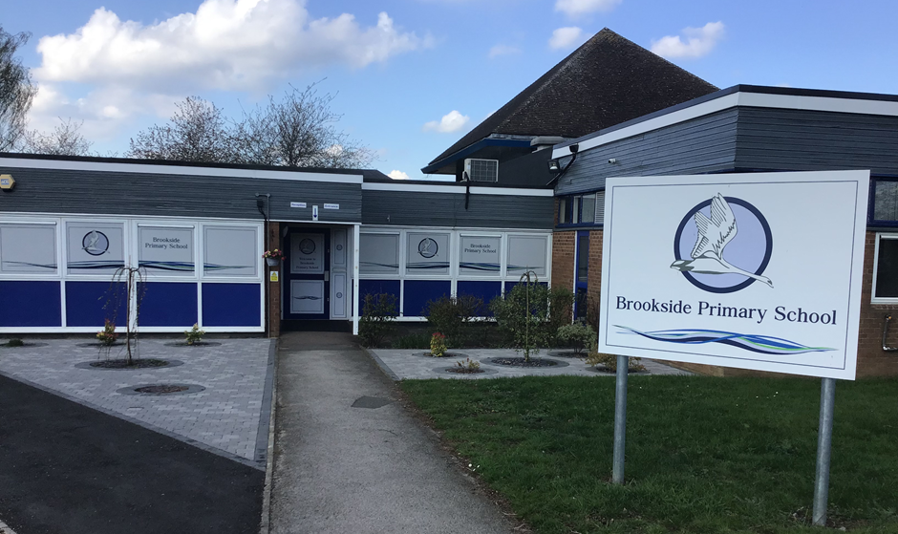
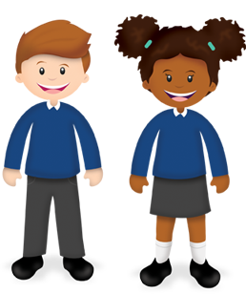
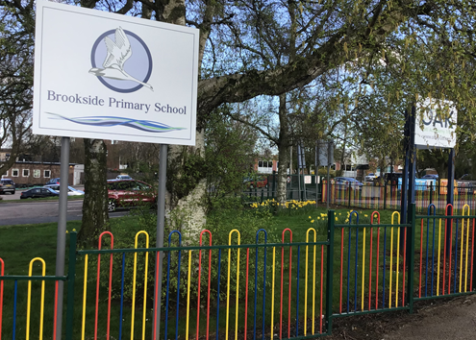
Welcome to Brookside
Come and have a look around!

Slide 2
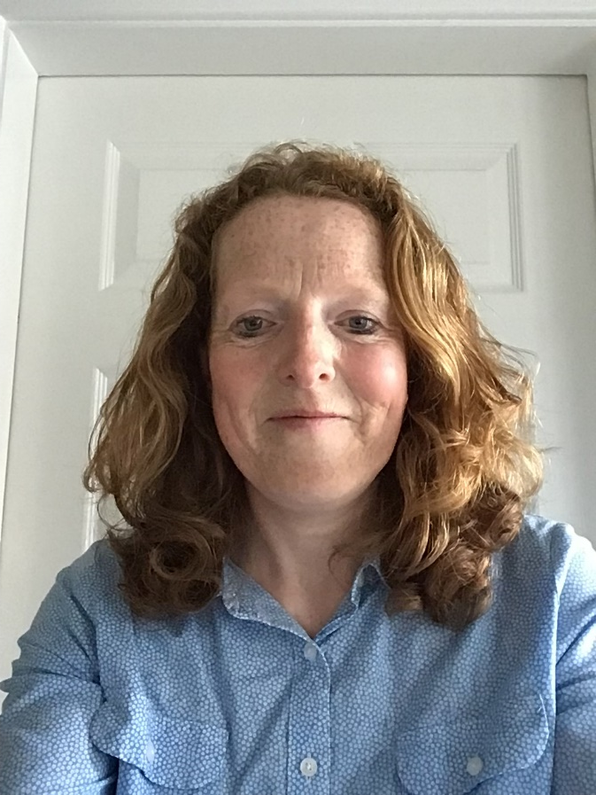
Who will help you at Brookside?
Hello I am Mrs Worrall and I am a teacher at Brookside. I like exploring outside, swimming and playing games.
Hello I am Mrs Creighton and I am a teacher at Brookside. I love PE, dancing and reading stories
Mrs Creighton
Mrs Worrall

Slide 3
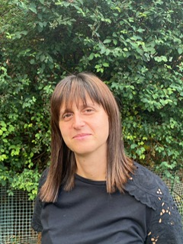
Hello I am Mrs Shergill and I teach the Red Admiral Class. I like making new friends.
Hello I am Mrs Corner. I work with all the Butterflies.
Hello I am Miss Jones and I work with all the Butterflies and I like playing outside.
Mrs Corner
Mrs Shergill
Miss Jones

Slide 4
Hello I am Mrs Chandarana. I work with the Holly Blues. I love dressing up and playing in the role play area.
Hello I am Mrs Lambat. I work with all the butterflies. I like cooking and painting.
Mrs Chandarana
Mrs Lambat

Slide 5
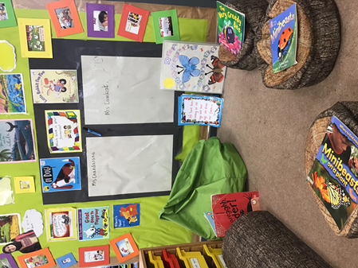
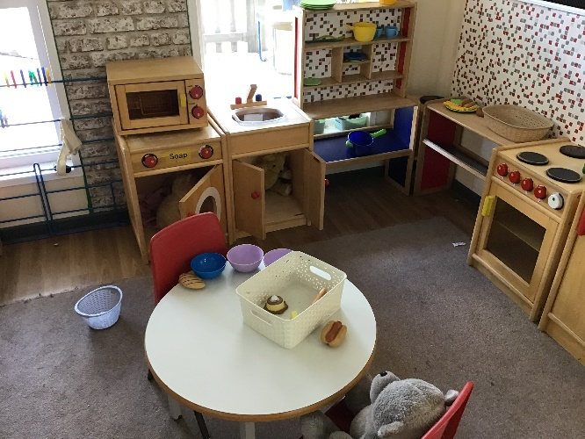
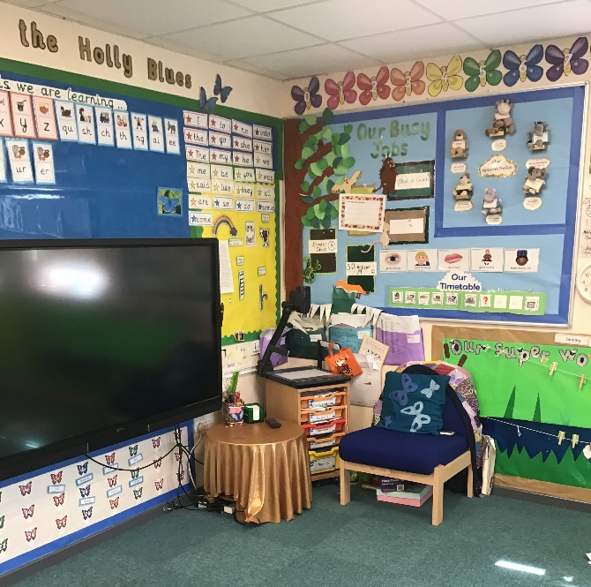
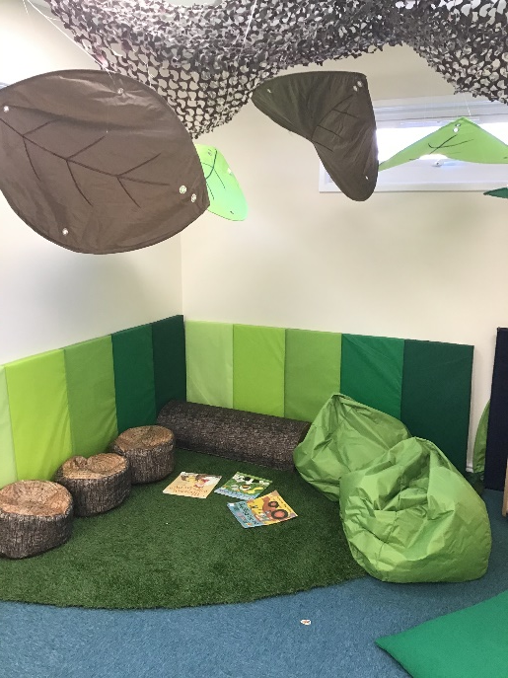
Your new classroom
Our classroom always has lots of things to play with. Our Teachers love putting our work up in the classroom!

Slide 6
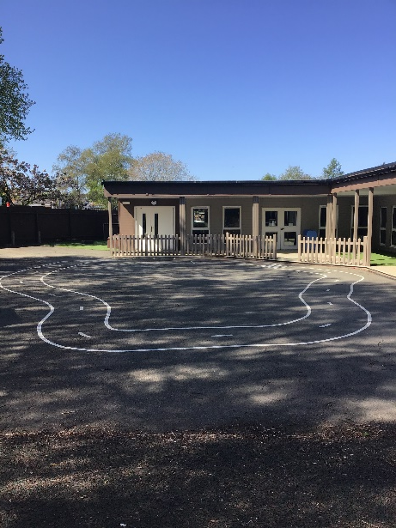
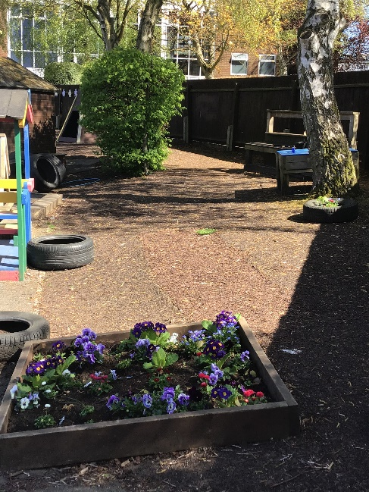
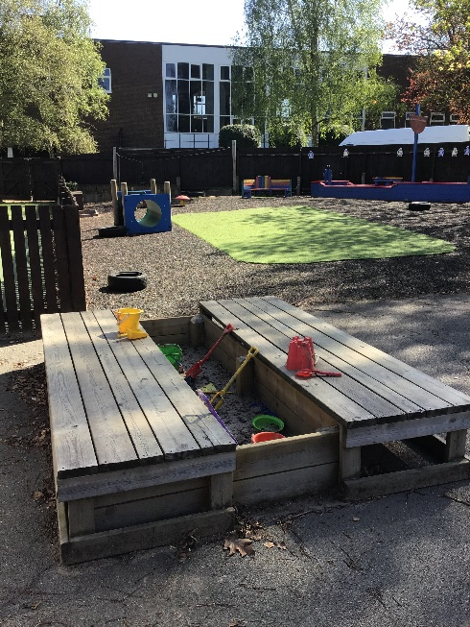
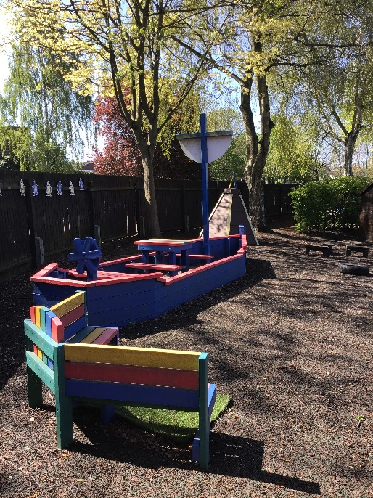
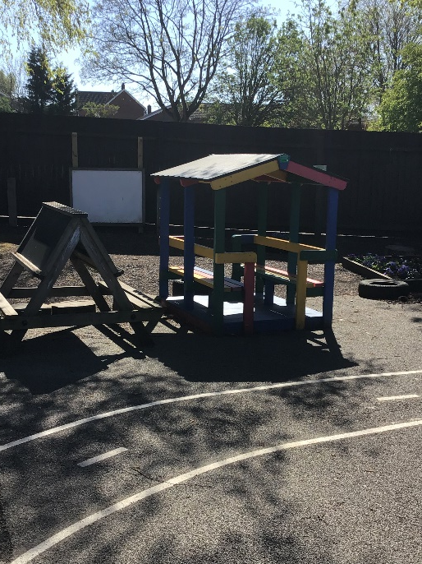
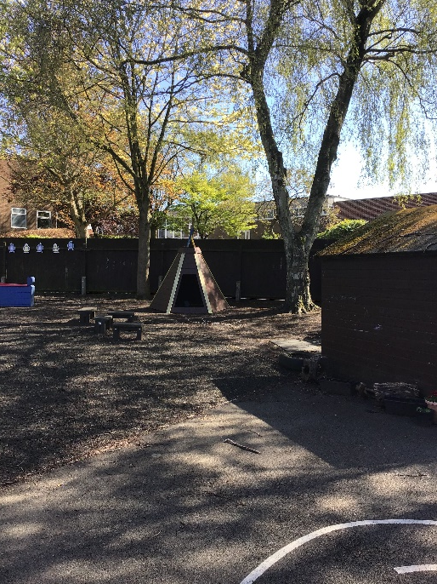
Playground
We have lots of space outside to play in.

Slide 7
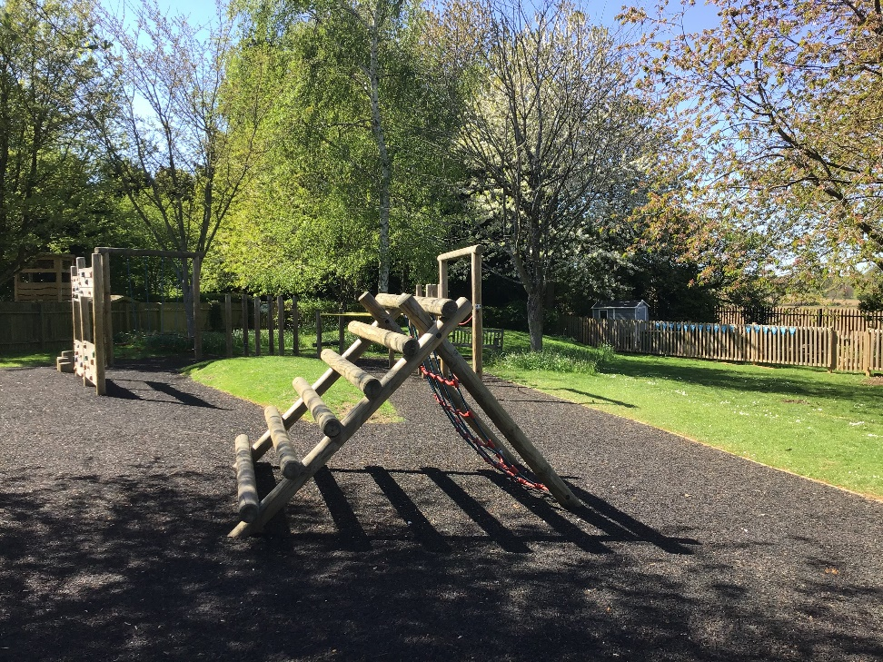
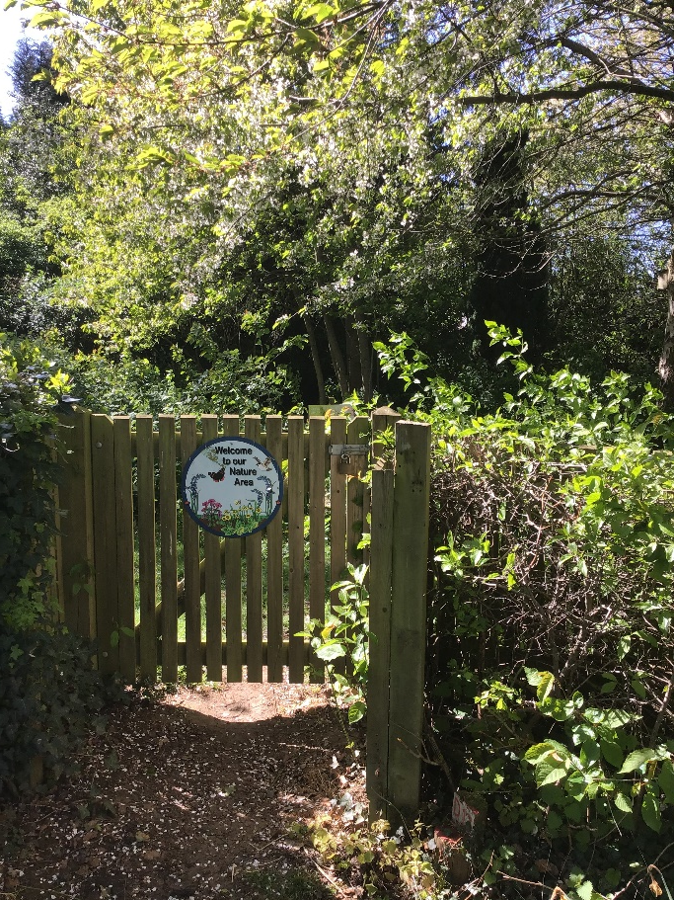
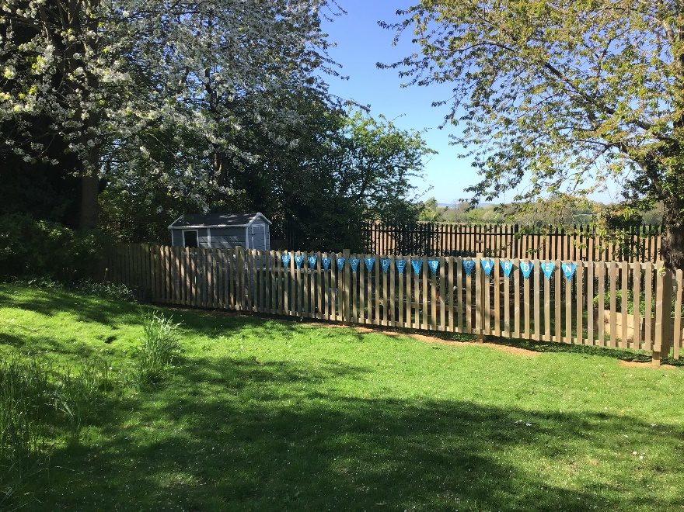
Outdoor environment
We also explore the other outdoor areas around School.

Slide 8
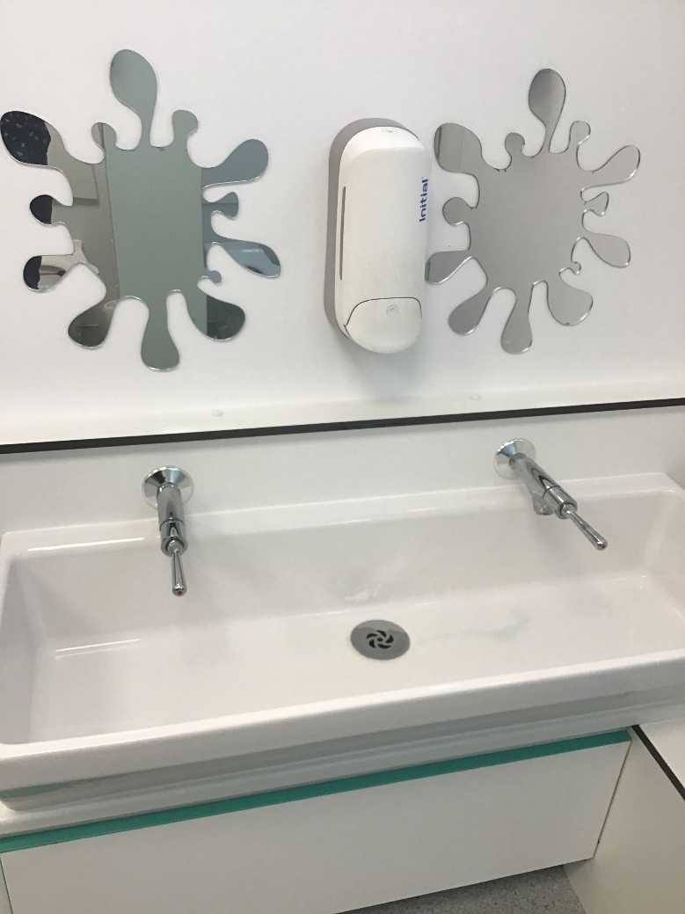
Toilets
These are our toilets, you can go to the toilet any time you want to. If you need some help, just ask one of the grown ups.

Slide 9
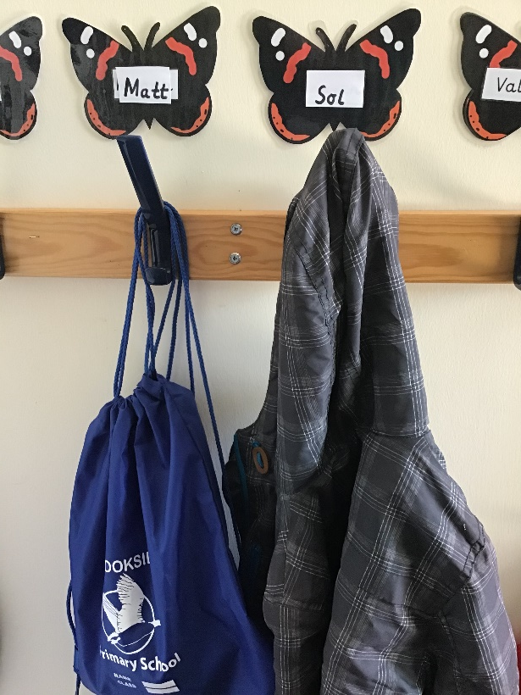
Our cloakrooms
You hang your coat and PE bag on your peg.
Everyone has a peg with their name on.
The Holly Blues have a cloakroom.
The Red Admirals have a cloakroom.

Slide 10
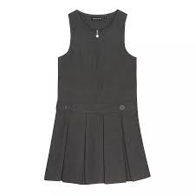
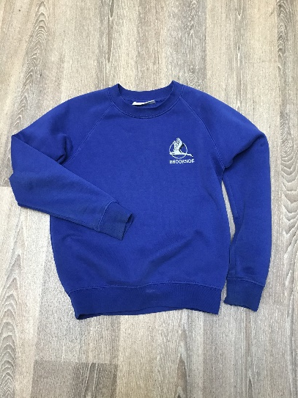
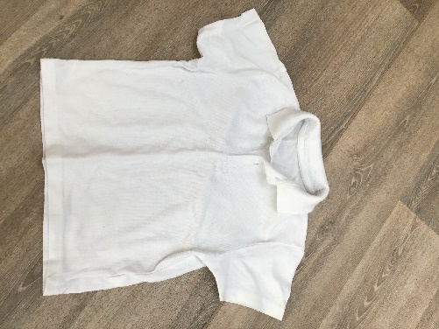
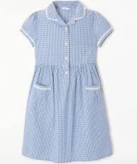
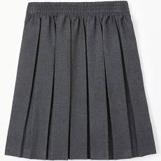
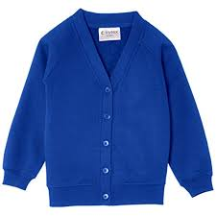
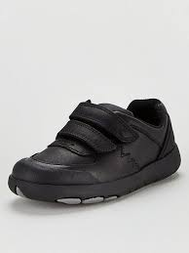
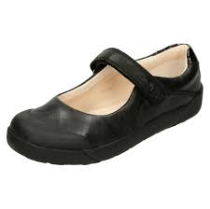
When you come to School you will wear our uniform
Our school uniform is royal blue and has our logo on but you can just have the plain blue cardigan or jumper.

Slide 11
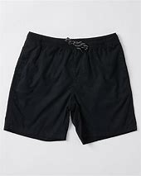
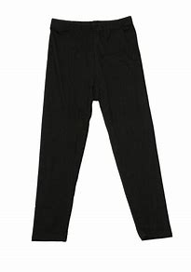
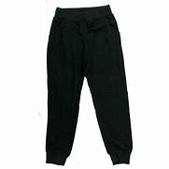
You will need to wear PE kit when we do PE.
plain white t-shirt (with a round neck)
Plain black shorts
Black leggings or tracksuit bottoms
or
We do PE in bare feet so you do NOT need plimsoles until the Summer Term

Slide 12
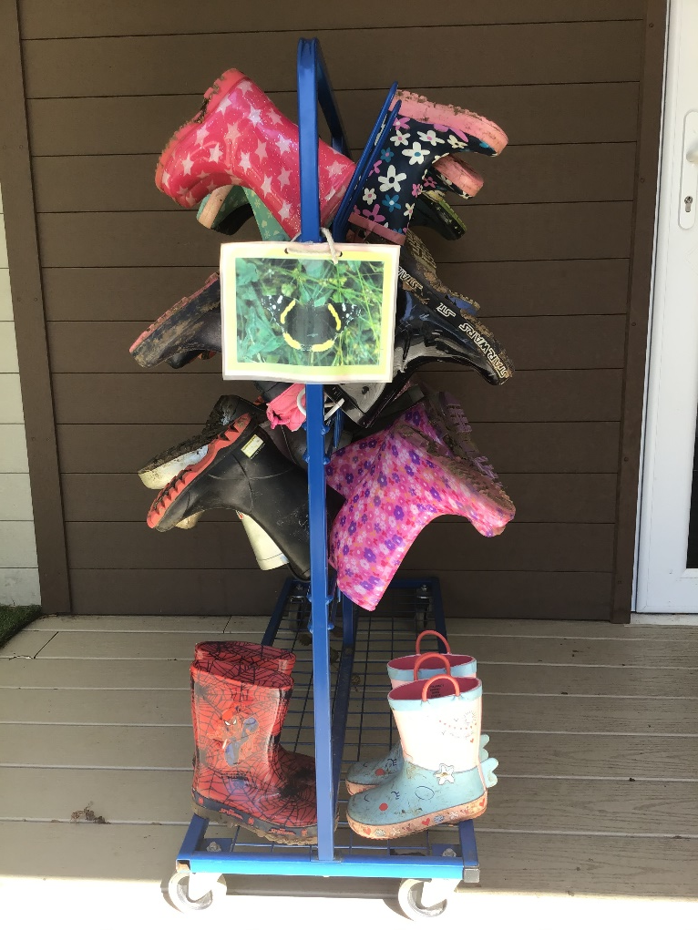
You need to bring to School..
Wellies to use when we do outdoor learning like gardening or visiting the nature area.

Slide 13
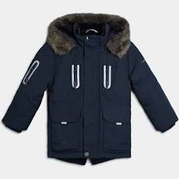
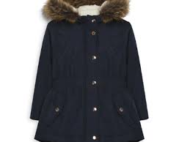
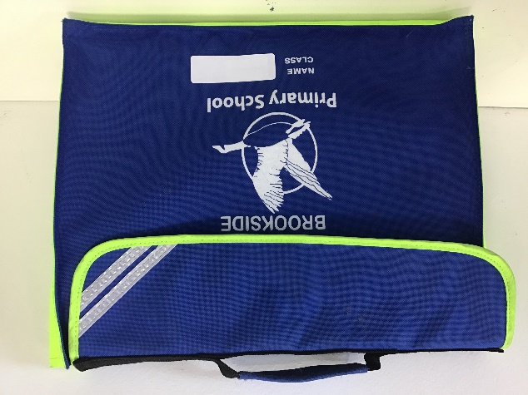
You also need to bring to School everyday….
Please make sure everything has your name on.
A water bottle
A warm, waterproof coat with a hood
A book bag to keep your reading books in

Slide 14
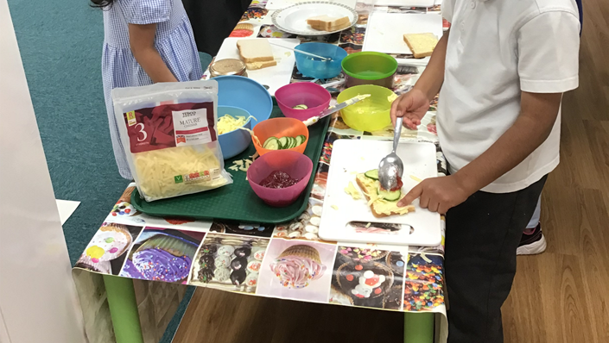
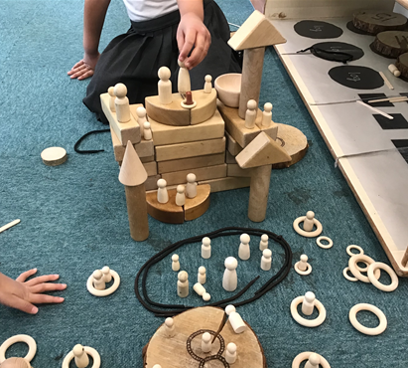
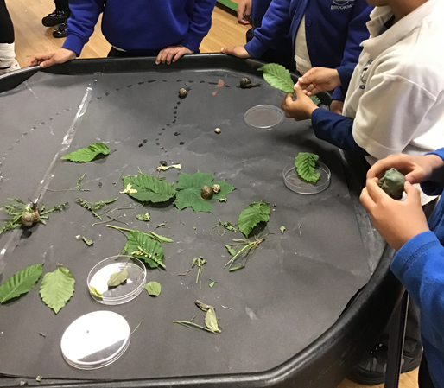
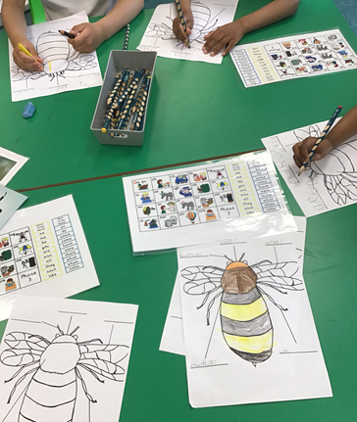
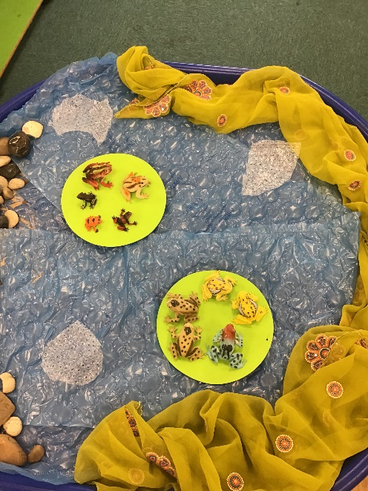
Activities
We are always getting busy in our classroom!

Slide 15
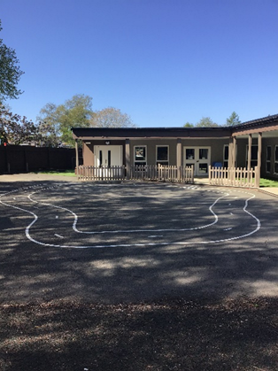
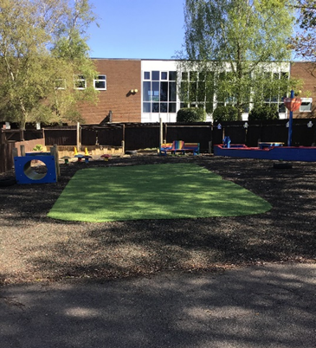
Lunchtime
This is our hall we have our School dinners or sandwiches here.
After we have eaten our dinner we can play in our playground and have fun!

Slide 16
We have two classes, both named after butterflies.
Mrs Shergill teaches the Red Admiral butterfly Class.
Mrs Creighton and Mrs Worrall teach the Holly Blue butterfly class.
Will you be a Holly Blue or a Red Admiral?

Slide 17
You will have lots of fun at Brookside.
We look forward to seeing you soon!

